Slide 1

6 Weeks of Summer Wellbeing Survival Tips

Slide 2
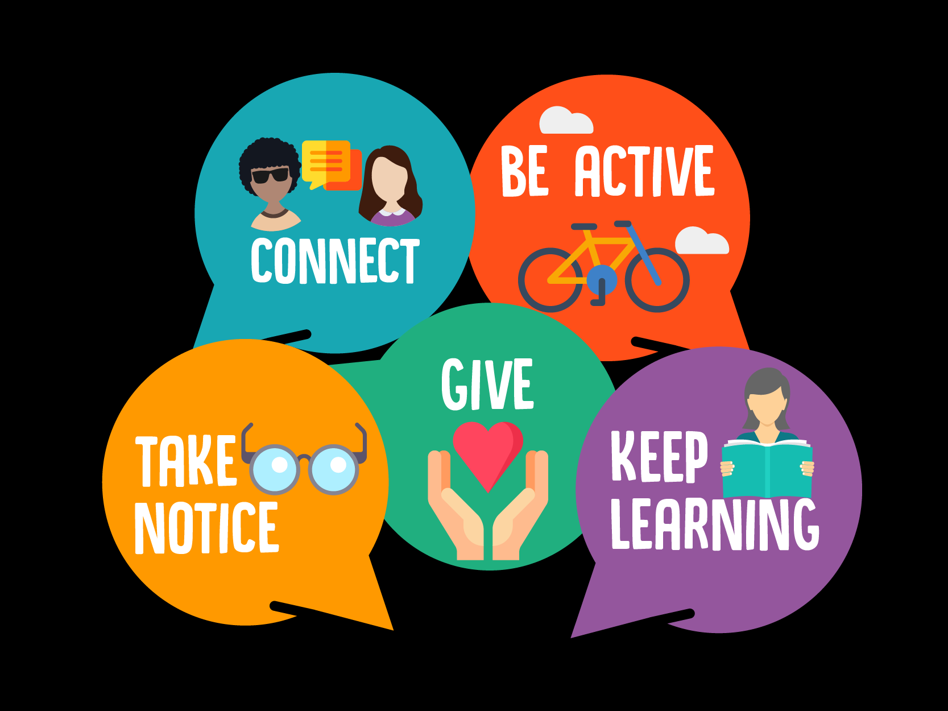
5 Ways to Wellbeing
Character trait developed: Ambition and the ones you want to focus on!

Slide 3
Who lived in a house like this?
Aspire. Dream. Achieve

Slide 4


Slide 5


Slide 6


Slide 7


Slide 8


Slide 9


Slide 10
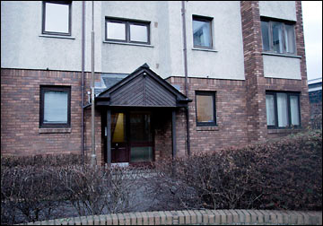

Slide 11


Slide 12
How did they all get there?
By grasping every opportunity
By not settling for second best in life
By not listening to those who settle for second best in life
By showing resilience in the face of failure
What are your plans this summer?
Final word from Will Smith:
https://www.youtube.com/watch?v=OTyN0upf8Ws

