Slide 1
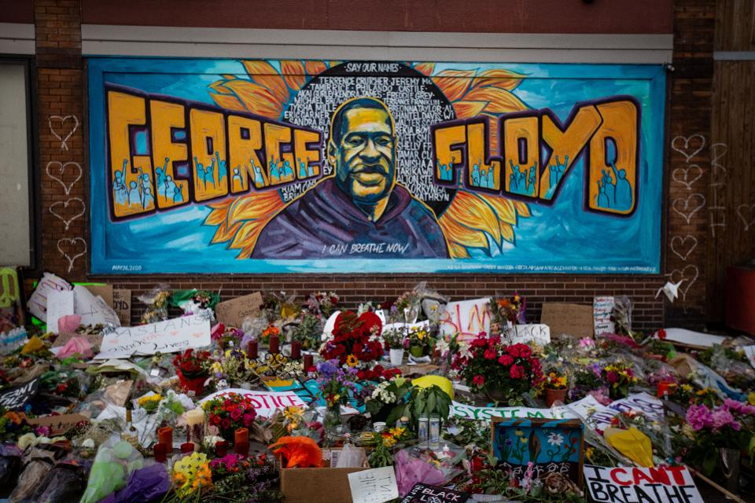
Racism:-
is actions, practices or beliefs, or social or political systems that consider different races to be ranked as inherently superior or inferior to each other
Xenophobia:-
comes from the Greek words ξένος (xenos), meaning "strange," "foreigner," and φόβος (phobos), meaning "fear
Character trait developed: Authenticity and Respect

Slide 2
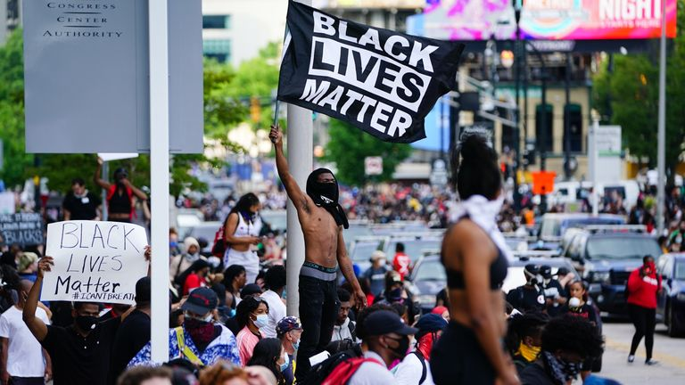
Racism and Xenophobia
George Floyd's death has sparked protests across the US, with demonstrators desperately calling for an end to police violence.
George Floyd was an unarmed black man who died after a Minneapolis police officer kneeled on his neck for more than eight minutes as he told them "I can't breathe".
Discuss why this has been such an influential event.

Slide 3
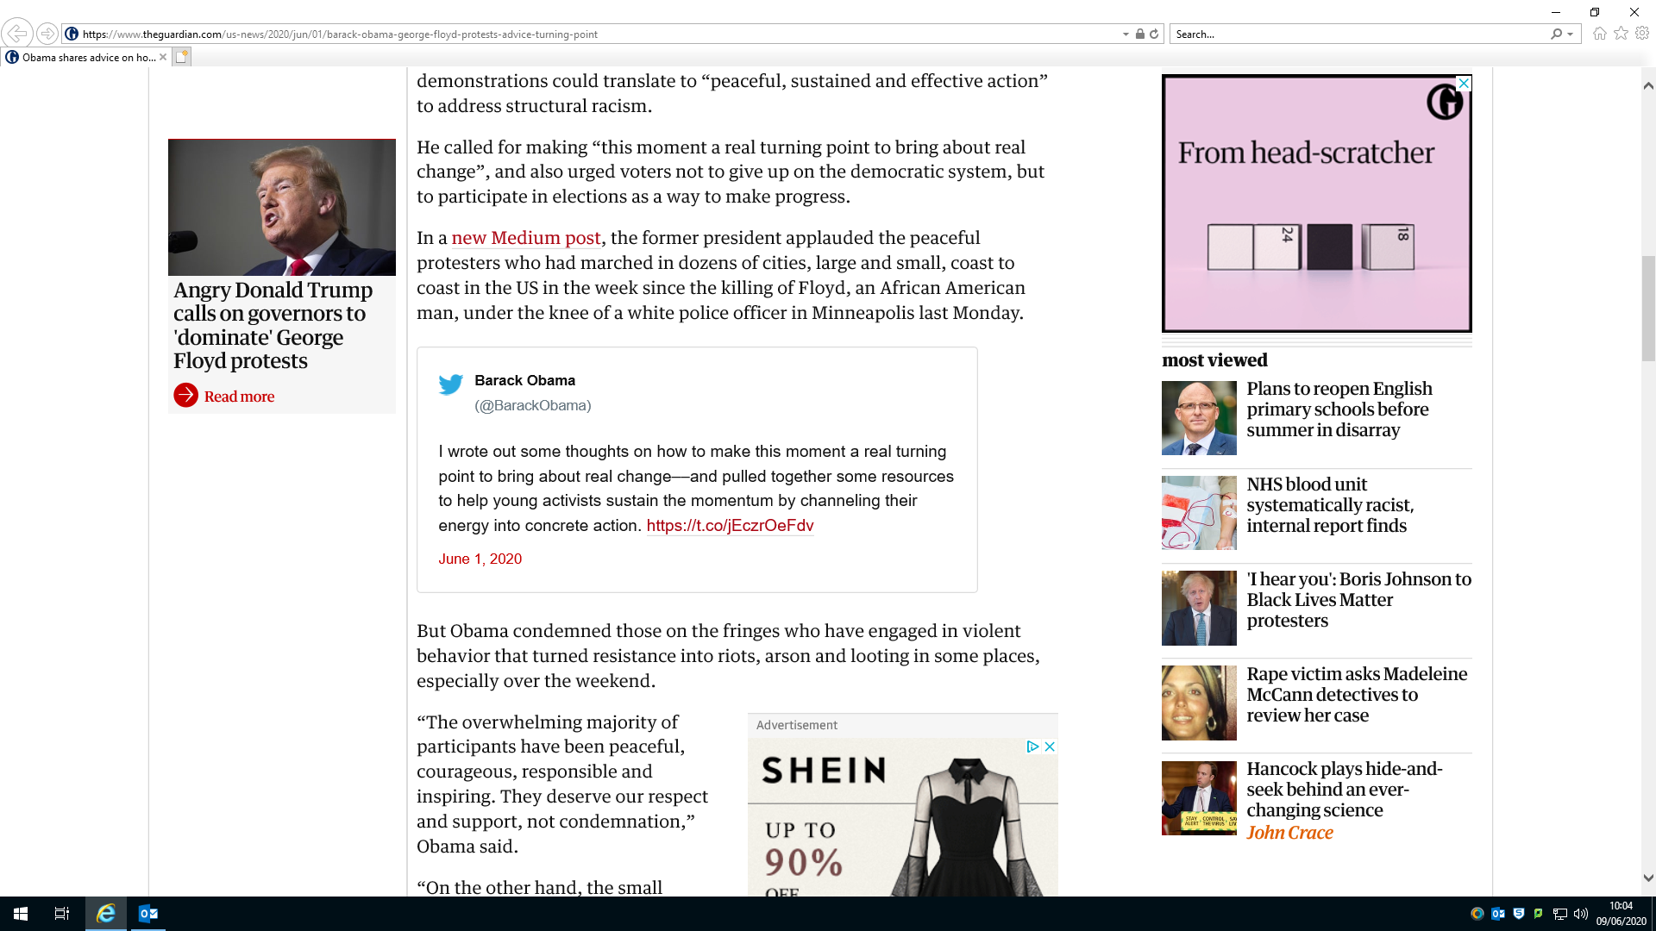
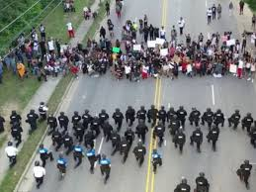
Peacefully: a much more powerful way to protest… https://www.birminghammail.co.uk/news/world-news/60-cops-kneel-support-george-18353767
Two presidential views – rather different approaches, Trump using force and Obama using peaceful protest. Consider how each one will have a different impact – in your opinion, which one is better?

Slide 4
https://www.bbc.co.uk/news/av/uk-england-devon-52984877/my-experience-growing-up-mixed-race-in-plymouth#share-tools
A poem written and performed by Evey – an ex student.

