Slide 1

Life: what does it mean to live your truth?
Notes:
Being authentic, being the ‘real’ you, not hiding things…

Slide 2
What might stop you from being the real you?
friends?
family?
school?
laws?
Notes:
Consider how these things might help or hinder authenticity

Slide 3

Have you ever felt that being ‘you’ wasn’t good enough?
Too tall?
Too short?
Wrong colour hair?
Wrong brand of trainers?
Not fast enough?
Not smart enough?
Too loud?
Too quiet?
Notes:
Please share your own personal experience if you can…

Slide 4


Slide 5
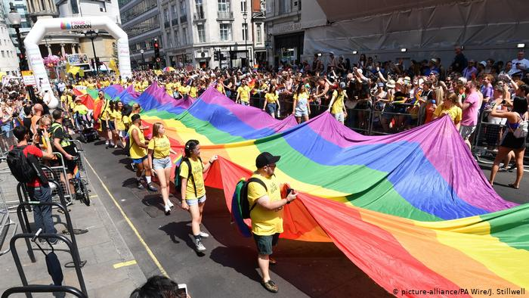
Why Pride?
The UK celebrates Pride month every June.
‘Pride’ was chosen as it is opposite to the way that LGBTQ+ people can be forced to live – in fear and secrecy.
History of Pride
Notes:
You may want to add that many LGBTQ+ people still live in this way, and that many become asylum seekers… This could touch on immigration

Slide 6
Why not straight pride? Consider:
Have you ever thought about how to tell your friends you’re straight?
Have you every thought about how to tell your family you’re straight?
Have you ever worried about what others will think of you if they find out you are straight?
In the future, will you have to think about how soon you tell new friends that you are straight?
If you go on holiday, do you need to check that your destination is safe for straight people?

Slide 7
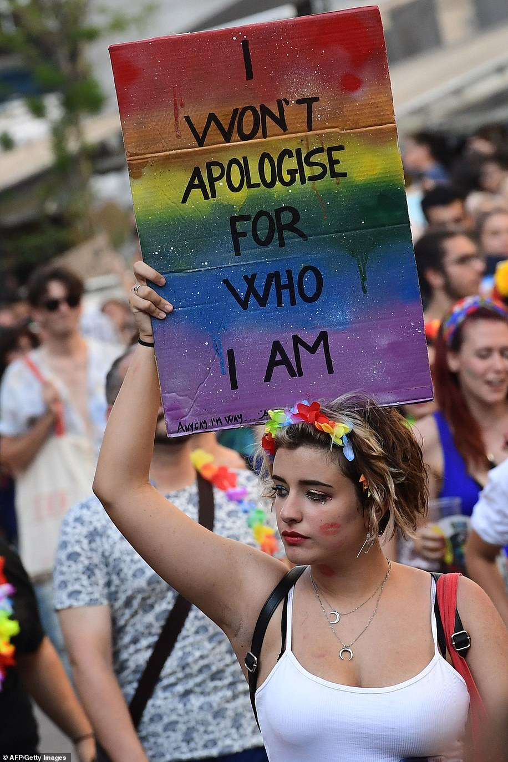
Pride month is not about taking rights away from one group to give to another: it’s about encouraging EVERYONE to live their truth.
Notes:
Question: doesn’t this message benefit everyone?

Slide 8


